Slide 1
Prepared by,
Dr.A.DEVI
Associate Professor
Department of Computer Applications
UNIT II : Big Data Tools

Slide 2
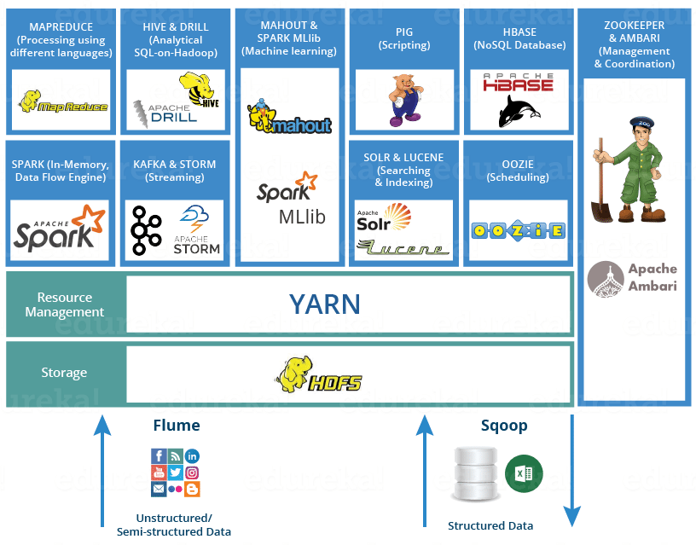

Slide 3
YARN
Consider YARN as the brain of your Hadoop Ecosystem. It performs all your processing activities by allocating resources and scheduling tasks.
It has two major components, i.e. Resource Manager and Node Manager.
Resource Manager is again a main node in the processing department. It receives the processing requests, and then passes the parts of requests to corresponding Node Managers accordingly, where the actual processing takes place.
Node Managers are installed on every Data Node. It is responsible for execution of task on every single Data Node.
Resource Manager has two components: Schedulers and application manager
1. Schedulers: Based on your application resource requirements, Schedulers perform scheduling algorithms and allocates the resources.
2. Applications Manager: While Applications Manager accepts the job submission, negotiates to containers (i.e. the Data node environment where process executes) for executing the application specific Application Master and monitoring the progress. Application Masters are the deamons which reside on DataNode and communicates to containers for execution of tasks on each DataNode.

Slide 4
Integrate.io
Integrate.io is a platform to integrate, process, and prepare data for analytics on the cloud.
It will bring all your data sources together.
This interface will help you with implementing ETL, ELT, or a replication solution.
Integrate.io is a complete toolkit for building data pipelines with low-code and no-code capabilities.
It has solutions for marketing, sales, support, and developers.
Integrate.io will help you make the most out of your data without investing in hardware, software, or related
Integrate.io provides support through email, chats, phone, and an online meetings.
Pros:
Integrate.io is an elastic and scalable cloud platform.
You will get immediate connectivity to a variety of data stores and a rich set of out-of-the-box data transformation components.
You will be able to implement complex data preparation functions by using Integrate.io’s rich expression language.
It offers an API component for advanced customization and flexibility.
Cons:
Only the annual billing option is available. It doesn’t allow you for the monthly subscription.

Slide 5
Adverity
Adverity is a flexible end-to-end marketing analytics platform that enables marketers to track marketing performance in a single view and effortlessly uncover new insights in real-time.
Its used for powerful data visualizations, and AI-powered predictive analytics,
This results in data-backed business decisions, higher growth, and measurable ROI.
Pros
Fully automated data integration from over 600 data sources.
Fast data handling and transformations at once.
Personalized and out-of-the-box reporting.
Customer-driven approach
High scalability and flexibility
Excellent customer support
High security and governance
Strong built-in predictive analytics
Easily analyze cross-channel performance with ROI Advisor.

Slide 6
Dextrus:
Dextrus helps you with self-service data ingestion, streaming, transformations, cleansing, preparation, wrangling, reporting, and machine learning modeling.
Pros:
Quick Insight on datasets: One of the components “DB Explorer” helps to query the data points to get a good insight on the data quickly using the power of the Spark SQL engine.
Query-based CDC: One of the options to identify and consume changed data from source databases into downstream staging and integration layers.
Log-based CDC: Another option to achieve real-time data streaming is by reading the db logs for identifying the continuous changes happening to the source data.
Anomaly detection: Data pre-processing or data cleansing is often an important step to provide the learning algorithm with a meaningful dataset to learn on.
Push-down Optimization
Data preparation at ease
Analytics all the way
Data Validation

Slide 7
Dataddo:
Dataddo is a no-coding, cloud-based ETL platform that puts flexibility first – with a wide range of connectors and the ability to choose your own metrics and attributes, Dataddo makes creating stable data pipelines simple and fast.
Pros:
Friendly for non-technical users with a simple user interface.
Can deploy data pipelines within minutes of account creation.
Flexibly plugs into users’ existing data stack.
No-maintenance: API changes managed by the Dataddo team.
New connectors can be added within 10 days from request.
Security: GDPR, SOC2, and ISO 27001 compliant.
Customizable attributes and metrics when creating sources.
Central management system to track the status of all data pipelines simultaneously.

Slide 8
Apache Hadoop:
Apache Hadoop is a software framework employed for clustered file system and handling of big data. It processes datasets of big data by means of the MapReduce programming model.
Hadoop is an open-source framework that is written in Java and it provides cross-platform support.
This is the topmost big data tool.
Some of the Big names include Amazon Web services, Hortonworks, IBM, Intel, Microsoft, Facebook, etc.
Pros:
The core strength of Hadoop is its HDFS (Hadoop Distributed File System) which has the ability to hold all type of data – video, images, JSON, XML, and plain text over the same file system.
Highly useful for R&D purposes.
Provides quick access to data.
Highly scalable
Highly-available service resting on a cluster of computers
Cons:
Sometimes disk space issues can be faced due to its 3x data redundancy.
I/O operations could have been optimized for better performance.

Slide 9
CDH (Cloudera Distribution for Hadoop)
CDH aims at enterprise-class deployments of that technology. It is totally open source and has a free platform distribution that encompasses Apache Hadoop, Apache Spark, Apache Impala, and many more.
It allows you to collect, process, administer, manage, discover, model, and distribute unlimited data.
Pros:
Comprehensive distribution
Cloudera Manager administers the Hadoop cluster very well.
Easy implementation.
Less complex administration.
High security and governance
Cons:
Few complicating UI features like charts on the CM service.
Multiple recommended approaches for installation sounds confusing.

Slide 10
Cassandra
Apache Cassandra is free of cost and open-source distributed NoSQL DBMS constructed to manage huge volumes of data spread across numerous commodity servers, delivering high availability. It employs CQL (Cassandra Structure Language) to interact with the database.
Some of the high-profile companies using Cassandra include Accenture, American Express, Facebook, General Electric, Honeywell, Yahoo, etc.
Pros:
No single point of failure.
Handles massive data very quickly.
Log-structured storage
Automated replication
Linear scalability
Simple Ring architecture
Cons:
Requires some extra efforts in troubleshooting and maintenance.
Clustering could have been improved.
Row-level locking feature is not there.

Slide 11
Knime
KNIME stands for Konstanz Information Miner which is an open source tool that is used for Enterprise reporting, integration, research, CRM, data mining, data analytics, text mining, and business intelligence. It supports Linux, OS X, and Windows operating systems.
It can be considered as a good alternative to SAS. Some of the top companies using Knime include Comcast, Johnson & Johnson, Canadian Tire, etc.
Pros:
Simple ETL operations
Integrates very well with other technologies and languages.
Rich algorithm set.
Highly usable and organized workflows.
Automates a lot of manual work.
No stability issues.
Easy to set up.
Cons:
Data handling capacity can be improved.
Occupies almost the entire RAM.
Could have allowed integration with graph databases.

Slide 12
Datawrapper
Datawrapper is an open source platform for data visualization that aids its users to generate simple, precise and embeddable charts very quickly.
Its major customers are newsrooms that are spread all over the world. Some of the names include The Times, Fortune, Mother Jones, Bloomberg, Twitter etc.
Pros:
Device friendly. Works very well on all type of devices – mobile, tablet or desktop.
Fully responsive
Fast
Interactive
Brings all the charts in one place.
Great customization and export options.
Requires zero coding.
Cons:
Limited color palettes

Slide 13
MongoDB
MongoDB is a NoSQL, document-oriented database written in C, C++, and JavaScript. It is free to use and is an open source tool that supports multiple operating systems including Windows Vista ( and later versions), OS X (10.7 and later versions), Linux, Solaris, and FreeBSD.
Its main features include Aggregation, Adhoc-queries, Sharding, Indexing, Replication, Server-side execution of javascript, Schemaless, Capped collection, MongoDB management service (MMS), load balancing and file storage.
Some of the major customers using MongoDB include Facebook, eBay, MetLife, Google, etc.
Pros:
Easy to learn.
Provides support for multiple technologies and platforms.
No hiccups in installation and maintenance.
Reliable and low cost.
Cons:
Limited analytics.
Slow for certain use cases.

Slide 14
Lumify
Lumify is a free and open source tool for big data fusion/integration, analytics, and visualization.
Its primary features include full-text search, 2D and 3D graph visualizations, automatic layouts, link analysis between graph entities, integration with mapping systems, geospatial analysis, multimedia analysis, real-time collaboration through a set of projects or workspaces.
Pros:
Scalable
Secure
Supported by a dedicated full-time development team.
Supports the cloud-based environment. Works well with Amazon’s AWS.

Slide 15
HPCC
HPCC stands for High-Performance Computing Cluster. This is a complete big data solution over a highly scalable supercomputing platform. HPCC is also referred to as DAS (Data Analytics Supercomputer). This tool was developed by LexisNexis Risk Solutions.
This tool is written in C++ and a data-centric programming language knowns as ECL(Enterprise Control Language). It is based on a Thor architecture that supports data parallelism, pipeline parallelism, and system parallelism. It is an open-source tool and is a good substitute for Hadoop and some other Big data platforms.
Pros:
The architecture is based on commodity computing clusters which provide high performance.
Parallel data processing.
Fast, powerful and highly scalable.
Supports high-performance online query applications.
Cost-effective and comprehensive.

Slide 16
Storm
Apache Storm is a cross-platform, distributed stream processing, and fault-tolerant real-time computational framework. It is free and open-source. The developers of the storm include Backtype and Twitter. It is written in Clojure and Java.
Its architecture is based on customized spouts and bolts to describe sources of information and manipulations in order to permit batch, distributed processing of unbounded streams of data.
Among many, Groupon, Yahoo, Alibaba, and The Weather Channel are some of the famous organizations that use Apache Storm.
Pros:
Reliable at scale.
Very fast and fault-tolerant.
Guarantees the processing of data.
It has multiple use cases – real-time analytics, log processing, ETL (Extract-Transform-Load), continuous computation, distributed RPC, machine learning.
Cons:
Difficult to learn and use.
Difficulties with debugging.
Use of Native Scheduler and Nimbus become bottlenecks.

Slide 17
Apache SAMOA
SAMOA stands for Scalable Advanced Massive Online Analysis. It is an open-source platform for big data stream mining and machine learning.
It allows you to create distributed streaming machine learning (ML) algorithms and run them on multiple DSPEs (distributed stream processing engines). Apache SAMOA’s closest alternative is BigML tool.
Pros:
Simple and fun to use.
Fast and scalable.
True real-time streaming.
Write Once Run Anywhere (WORA) architecture.

Slide 18
Talend
Open studio for Big data: It comes under free and open source license. Its components and connectors are Hadoop and NoSQL. It provides community support only.
Big data platform: It comes with a user-based subscription license. Its components and connectors are MapReduce and Spark. It provides Web, email, and phone support.
Real-time big data platform: It comes under a user-based subscription license. Its components and connectors include Spark streaming, Machine learning, and IoT. It provides Web, email, and phone support.
Pros:
Streamlines ETL and ELT for Big data.
Accomplish the speed and scale of spark.
Accelerates your move to real-time.
Handles multiple data sources.
Provides numerous connectors under one roof, which in turn will allow you to customize the solution as per your need.
Cons:
Community support could have been better.
Could have an improved and easy to use interface
Difficult to add a custom component to the palette.

Slide 19
Rapidminer
Rapidminer is a cross-platform tool which offers an integrated environment for data science, machine learning and predictive analytics. It comes under various licenses that offer small, medium and large proprietary editions as well as a free edition that allows for 1 logical processor and up to 10,000 data rows.
Organizations like Hitachi, BMW, Samsung, Airbus, etc have been using RapidMiner.
Pros:
Open-source Java core.
The convenience of front-line data science tools and algorithms.
Facility of code-optional GUI.
Integrates well with APIs and cloud.
Superb customer service and technical support.
Cons:
Online data services should be improved.

Slide 20
R
R is one of the most comprehensive statistical analysis packages. It is open-source, free, multi-paradigm and dynamic software environment. It is written in C, Fortran and R programming languages.
It is broadly used by statisticians and data miners. Its use cases include data analysis, data manipulation, calculation, and graphical display.
Pros:
R’s biggest advantage is the vastness of the package ecosystem.
Unmatched Graphics and charting benefits.
Cons:
Its shortcomings include memory management, speed, and security.

Slide 21
Elasticsearch
Elastic search is a cross-platform, open-source, distributed, RESTful search engine based on Lucene.
It is one of the most popular enterprise search engines. It comes as an integrated solution in conjunction with Logstash (data collection and log parsing engine) and Kibana (analytics and visualization platform) and the three products together are called as an Elastic stack.
Stata wing
Statwing is a friendly to use statistical tool that has analytics, time series, forecasting and visualization features. Its starting price is $50.00/month/user. A free trial is also available.

Slide 22
Flink
Apache Flink is an open-source, cross-platform distributed stream processing framework for data analytics and machine learning. This is written in Java and Scala. It is fault tolerant, scalable and high-performing.
DataCleaner
Quadient DataCleaner is a Python-based data quality solution that programmatically cleans data sets and prepares them for analysis and transformation.
Kaggle
Kaggle is a data science platform for predictive modeling competitions and hosted public datasets. It works on the crowdsourcing approach to come up with the best models.

Slide 23
Hive
Apache Hive is a java based cross-platform data warehouse tool that facilitates data summarization, query, and analysis.
Spark
Apache Spark is an open source framework for data analytics, machine learning algorithms, and fast cluster computing. This is written in Scala, Java, Python, and R.
OpenText
OpenText Big data analytics is a high performing comprehensive solution designed for business users and analysts which allows them to access, blend, explore and analyze data easily and quickly.
Oracle Data Mining
ODM is a proprietary tool for data mining and specialized analytics that allows you to create, manage, deploy and leverage Oracle data and investment

Slide 24
Teradata
Teradata company provides data warehousing products and services. Teradata analytics platform integrates analytic functions and engines, preferred analytic tools, AI technologies and languages, and multiple data types in a single workflow.
BigML
Using BigML, you can build superfast, real-time predictive apps. It gives you a managed platform through which you create and share the dataset and models.

